Slide 1
Document Scanner using Various Edge Detection Techniques Mini - Project
Aman Kumar 201911018
Harsh Vardhan Singh 201911022

Slide 2
Table of Contents
What is Edge detection
Types of Edge Detection Methods
Sobel Edge Detector
Prewitt Edge Detector
Laplacian Edge Detector
Canny Edge Detector
Comparison of Edge Detectors
Steps in Document Scanner
Contour Detection
Perspective Transformation
Thresholding and Final Results

Slide 3
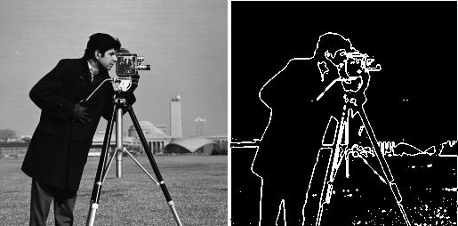
What is Edge Detection?
The points at which image brightness changes sharply are typically organized into a set of curved line segments termed edges.
Edge detection includes a variety of mathematical methods that aim at identifying points in a digital image at which the image brightness changes sharply or, more formally, has discontinuities.
Edge detection is a fundamental tool in image processing, machine vision and computer vision, particularly in the areas of feature detection and feature extraction.

Slide 4
Types of Edge Detection Methods
Sobel Edge Detector
Prewitt Edge Detector
Laplacian Edge Detector
Canny Edge Detector

Slide 5
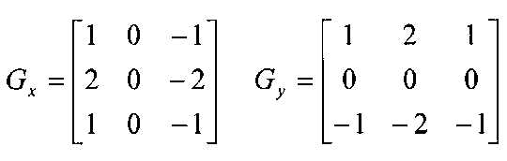
Sobel Edge Detector
The Sobel is one of the most commonly used edge detectors. It is based on convolving the image with a small, separable, and integer valued filter in horizontal and vertical direction and is therefore relatively inexpensive in terms of computations. The Sobel edge enhancement filter has the advantage of providing differentiating (which gives the edge response) and smoothing (which reduces noise) concurrently.
The major difference is that in sobel operator the coefficients of masks are not fixed and they can be adjusted according to our requirement unless they do not violate any property of derivative masks.
Advantages : Simple to use, able to detect edge with their orientation.
Disadvantages: Sensitive to noise, low accuracy.

Slide 6
Working of Sobel Edge Detector
Sobel Vertical Mask
Sobel Horizontal Mask
When we apply this mask on the image it prominent vertical edges. It simply works like as first order derivate and calculates the difference of pixel intensities in a edge region.
As the centre column is of zero so it does not include the original values of an image but rather it calculates the difference of right and left pixel values around that edge. Also the centre values of both the first and third column is 2 and -2 respectively.
This give more weight age to the pixel values around the edge region. This increase the edge intensity and it become enhanced comparatively to the original image.
This mask will prominent the horizontal edges in an image. It also works on the principle of above mask and calculates difference among the pixel intensities of a particular edge. As the centre row of mask is consist of zeros so it does not include the original values of edge in the image but rather it calculate the difference of above and below pixel intensities of the particular edge. Thus increasing the sudden change of intensities and making the edge more visible.

Slide 7
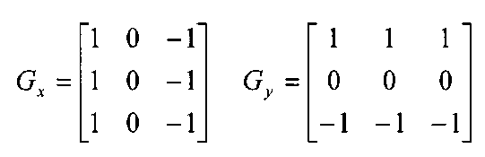
Prewitt Edge Detector
Prewitt operator is similar to the Sobel operator and is used for detecting vertical and horizontal edges in images. However, unlike the Sobel, this operator does not place any emphasis on the pixels that are closer to the centre of the mask.
Advantages : Simple to use, able to detect edge with their orientation.
Disadvantages: Sensitive to noise, low accuracy.

Slide 8
Working of Prewitt Edge Detector
Prewitt Vertical Mask
Prewitt Horizontal Mask
When we apply this mask on the image it prominent vertical edges. It simply works like as first order derivate and calculates the difference of pixel intensities in a edge region. As the center column is of zero so it does not include the original values of an image but rather it calculates the difference of right and left pixel values around that edge. This increase the edge intensity and it become enhanced comparatively to the original image.
This mask will prominent the horizontal edges in an image. It also works on the principle of above mask and calculates difference among the pixel intensities of a particular edge. As the center row of mask is consist of zeros so it does not include the original values of edge in the image but rather it calculate the difference of above and below pixel intensities of the particular edge. Thus increasing the sudden change of intensities and making the edge more visible. Both the above masks follow the principle of derivate mask. Both masks have opposite sign in them and both masks sum equals to zero. The third condition will not be applicable in this operator as both the above masks are standardize and we can’t change the value in them.

Slide 9
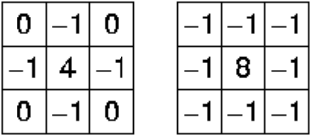
Laplacian Edge Detector
Laplacian is somewhat different from the methods we have discussed so far. Unlike the Sobel and Prewitt’s edge detectors, the Laplacian edge detector uses only one kernel. It calculates second order derivatives in a single pass. Two commonly used small kernels are:
Advantages : Fixed characteristics, able to detect edges with their orientation.
Disadvantages: Sensitive to noise, low accuracy, diffraction by existing edges.

Slide 10
Working of Laplacian Edge Detector
Laplacian is a derivative operator; its uses highlight gray level discontinuities in an image and try to deemphasize regions with slowly varying gray levels. This operation in result produces such images which have grayish edge lines and other discontinuities on a dark background. This produces inward and outward edges in an image
The important thing is how to apply these filters onto image. Remember we can’t apply both the positive and negative Laplacian operator on the same image. we have to apply just one but the thing to remember is that if we apply positive Laplacian operator on the image then we subtract the resultant image from the original image to get the sharpened image. Similarly if we apply negative Laplacian operator then we have to add the resultant image onto original image to get the sharpened image.

Slide 11
Canny Edge Detector
Canny edge detector is probably the most commonly used and most effective method ,it uses a multi-stage algorithm to detect a wide range of edges in images.
Steps for Canny Edge Detection :
1. Smooth the image with a Gaussian filter to reduce noise.
2. Compute gradient
3. Non-maximum suppression
4. Thresholding

Slide 12
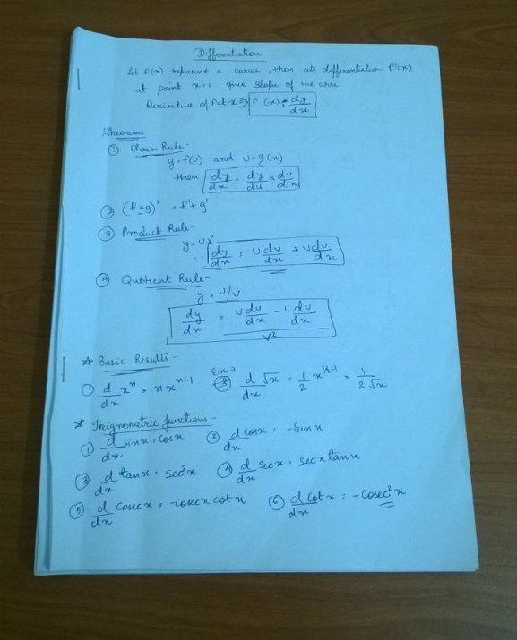
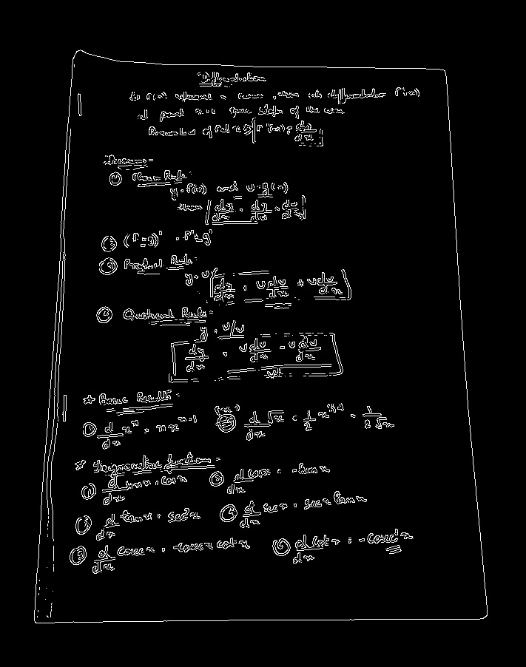
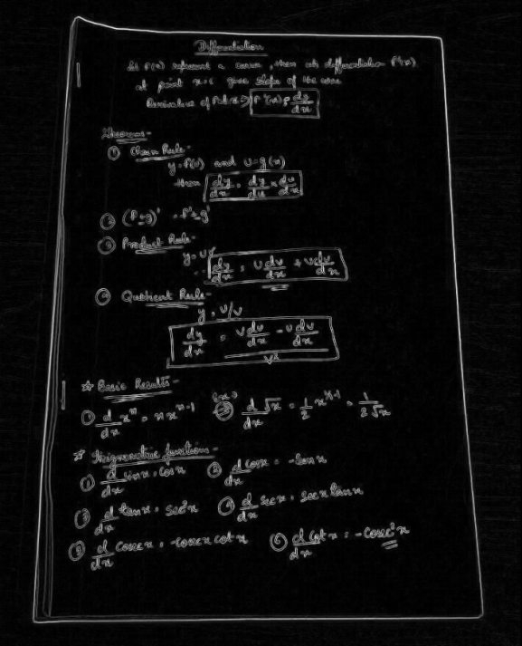
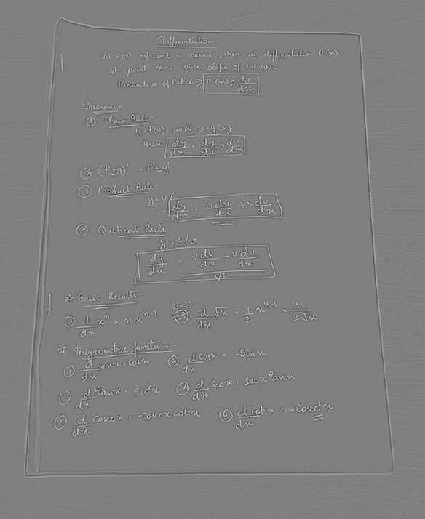
Comparing Results
Canny Edge
Sobel Edge
Laplacian Edge
Original Image
Canny edge detector gives the best crisp edges.
Greyish edge lines and other discontinuities on a dark background. This produces inward and outward edges in an image
Sobel edge detector
gives thicker and disturbed edges.

Slide 13
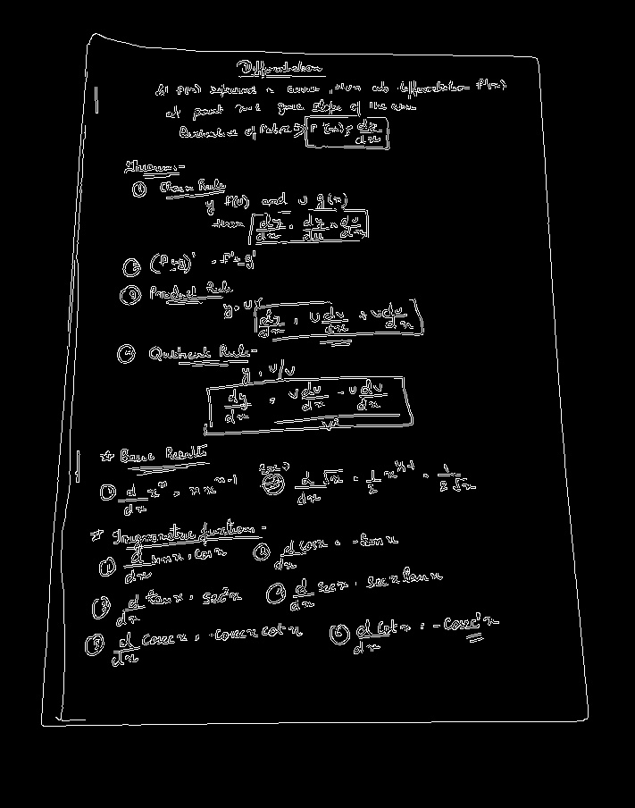
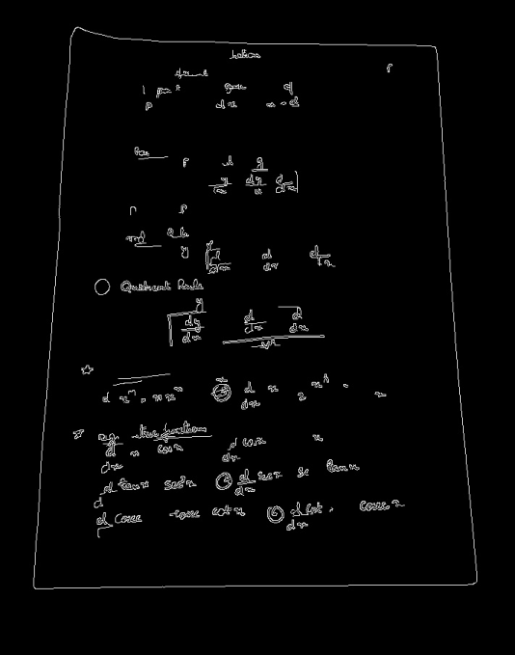
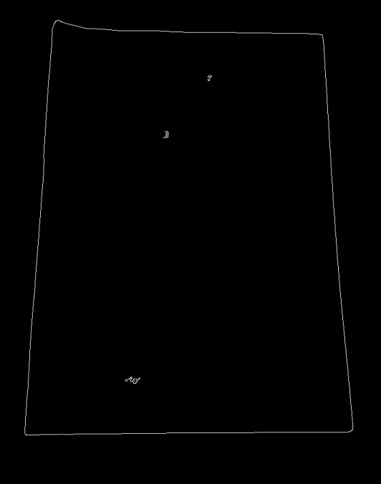
Smoothing
Images taken from a camera will contain some amount of noise. As noise can mislead the result in finding edges, we have to reduce the noise. Therefore the images are first smoothed by applying a Gaussian Filter.
The Gaussian Filter results depends upon the size of kernel we use.
1x1
3x3
5x5

Slide 14
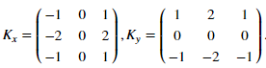
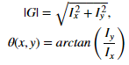
Computing Gradients
The gradient calculation step is used to detect the edge intensity and direction.
We can compute the gradient by applying Sobel Kernels.
Magnitude and the slope of the gradient is calculated by :

Slide 15
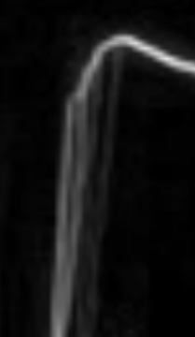

Non Maximum Suppression
Non maximum suppression is used to create thin edges.
The algorithm goes through all the points on the gradient intensity matrix and finds the pixel with maximum value in edge direction.
Non-maximum suppression can help to suppress all the gradient values (by setting them to 0) except the local maxima, which indicate locations with the sharpest change of intensity value.

Slide 16
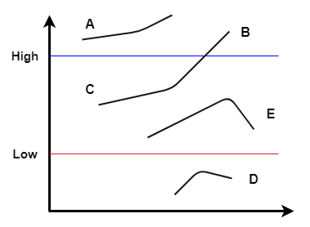
Hysteresis Thresholding
Hysteresis thresholding decides the edges that we need to keep in our image and neglect the other edges.
Low and High thresholds are used to remove unwanted edges.
Any edge below the low threshold is rejected .
Edges above the high threshold are accepted.
Edges between high and low threshold are selected only if they are connected to an high threshold.

Slide 17
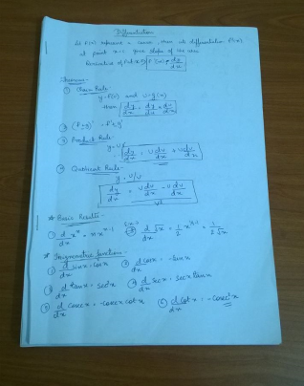
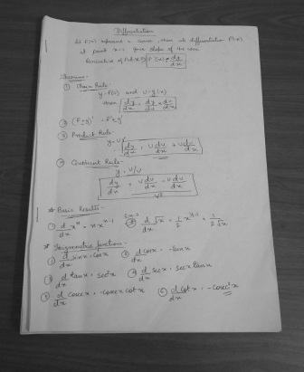

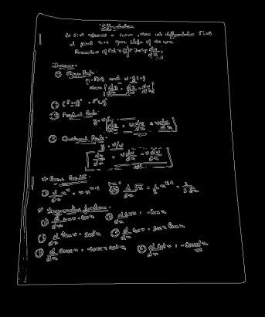
Steps for Document Scanner
Input
Image
Grayscale
Gaussian Blur
Canny Edge
Any dimension image directly clicked by phone camera.
Gaussian Blur is applied to remove
High frequency data, this avoids unwanted edges.
Images are converted
to grayscale for
reducing complexity

Slide 18

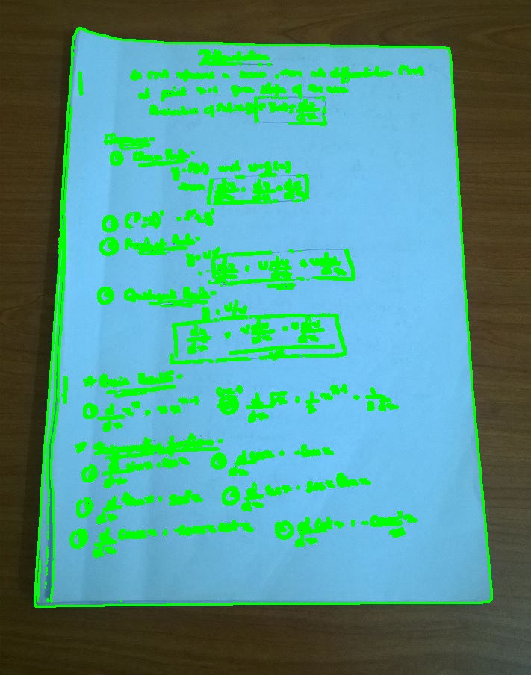
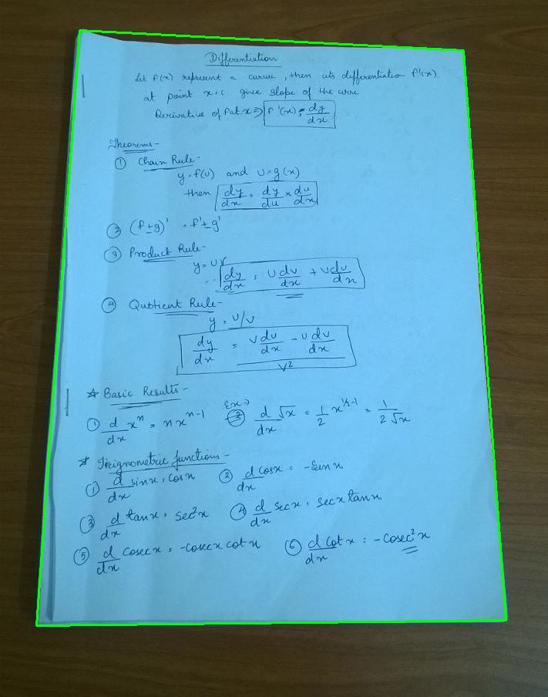
Contour Detection
Contour Detection : Contours can be explained simply as a curve joining all the continuous points (along the boundary).
We find all the contours in an Image.
Look for the largest contour.

Slide 19
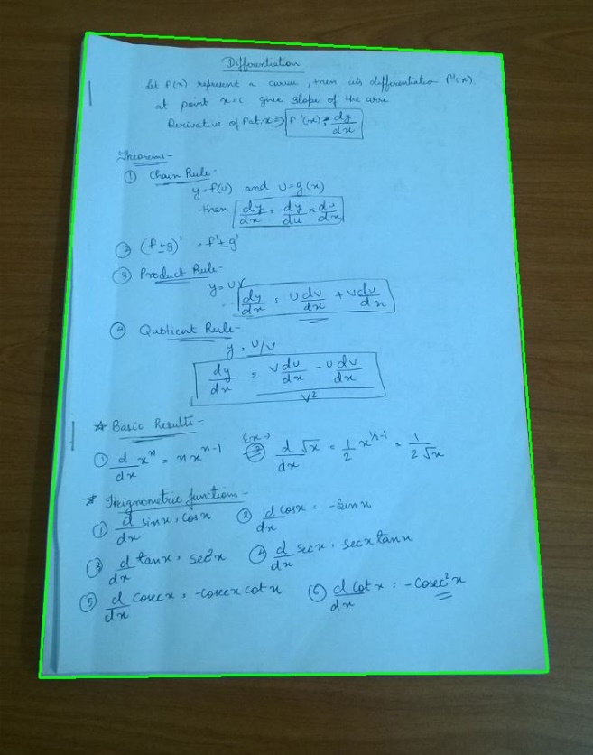
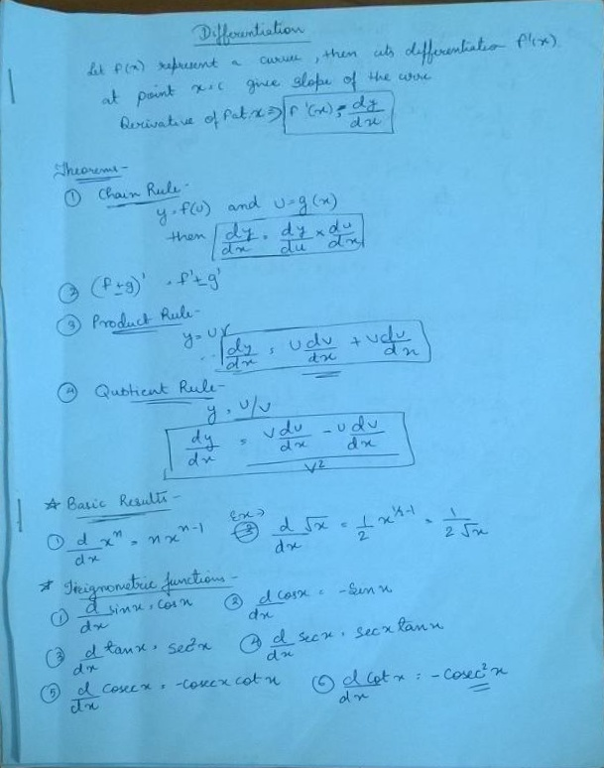
Perspective Transform
We can change the perspective of a given image for getting better insights about the required information.
We get the perspective transform from the two given set of points and wrap it with the original image.

Slide 20
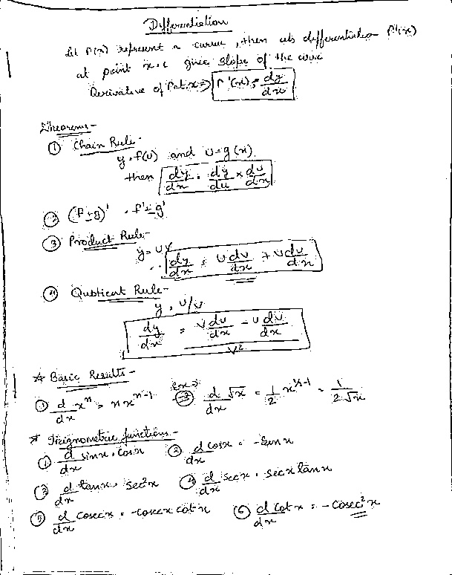
Contrast Adjustment and Final Result
Adjusting the contrast of the image to get the clear scanned page.
Local thresholding/Adaptive thresholding is applied to get the result.
Mean Thresholding:
threshold value is the mean of neighbourhood area.

Slide 21
Limitations of Canny Edge Detection
The amount of parameters leads to infinitely tweaking for getting just that little better result.
Also due to the Gaussian smoothing: the location of the edges might be off, depending on the size of the Gaussian kernel.
Fails in varying lighting condition.
The method has problems with corners and junctions:
The Gaussian smoothing blurs them out, making them harder to detect (same goes for the edges themself)
The corner pixels look in the wrong directions for their neighbours, leaving open ended edges, and missing junctions

Slide 22
Thank You

